Slide 1
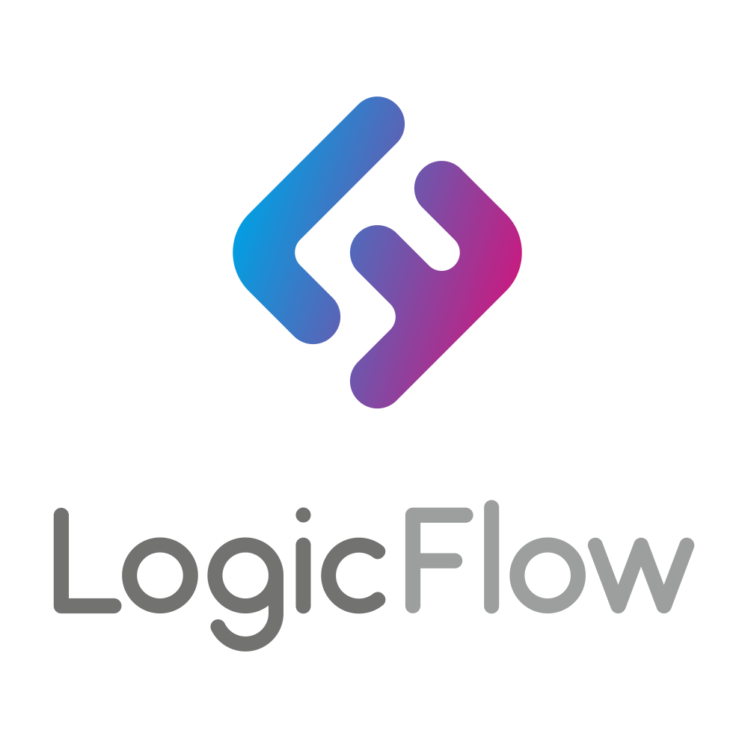

LogicFlow
Intelligent Logistics Platform Using IoT and Blockchain for Transparent Supply Chains
Feras Mohammad 19INDE1086
Khud Bakhtiyar Sofi 21MECT1049
Emadeden Albaghdadi 21INDE1049
Supervised by: Dr. MEHMET CEMAL GÜLLÜOĞLU

Slide 2


Contents
Company Overview
Current State & Challenges
SWOT Analysis
Strategy & KPIs
Business Models
Technical Infrastructure
Execution Plan
Collaboration and Integration
Technologies and Assets
Expected Business Value
Ensuring Project Success
Conclusion

Slide 3
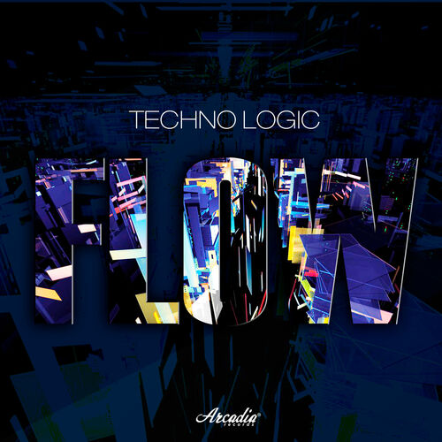
Company Overview
Company Name: LogicFlow Technologies (fictional)
Location: Rotterdam, Netherlands
Industry: Freight forwarding, 3PL, and customs clearance
Mission: To redefine global logistics through transparency, traceability, and trust using intelligent digital systems.
Vision: Become the global standard for smart, secure, and data-driven supply chains.

Slide 4
Current State & Challenges
Current State
Challenges
LogicFlow is already a strong regional logistics company.
They still uses a lot of manual work.
Inefficient routing and customs processes take a lot of time.
No real-time tracking.
Systems are not connected.
Delivery problems
Increasing customer demand.

Slide 5
SWOT Analysis
Strengths
Trusted logistics network
Expert workforce
Connected with international shipping services
Weaknesses
Manual workflows
Limited data sharing across departments
Basic IT infrastructure
Opportunities
EU rules support digital shipping
More people want to see where their packages are
Technology is getting better by using AI
Threats
There is a lot of competition with other companies
Cybersecurity
Shipping delays around the world

Slide 6
Strategy & KPIs
Strategic Pillars
KPIs
Use IoT (Internet of Things) to track goods
Use blockchain for secure documents
Using AI Optimization to find better routes
70% reduction in missing shipments
30% faster customs clearance
80+ NPS (Net Promoter Score) from clients
40% increase in system-based process automation

Slide 7
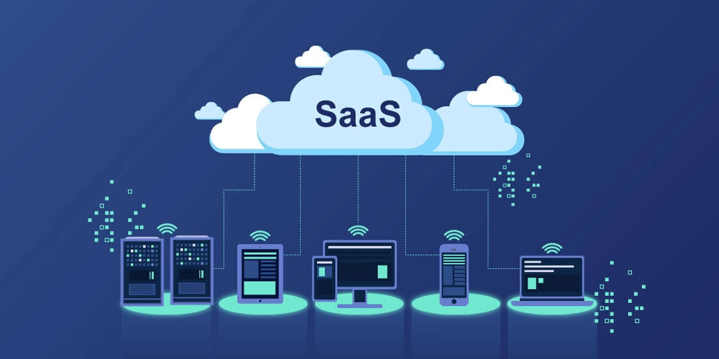
Business Models
SaaS Platform Licenses: Tiered access for logistics partners
Pay-per-transaction: Smart contract and customs integration (ERP system)
Data monetization: Predictive analytics sold to large clients (trend,risk analysis).
Consulting Services: For digital onboarding and change management

Slide 8
Technical Infrastructure
Architecture Functions
Pull: Track and view all shipments in real-time
Match: AI routes optimization and ETA forecasting
Facilitate: Auto-generate customs and compliance documents
Make sure shipments follow the rules
Platform Design
Scalable cloud architecture (AWS/Azure)
Hyperledger for blockchain records
IoT tracking devices (GPS, temp, humidity)
Secure API ecosystem for partner integration

Slide 9
Execution Plan
Infrastructure Setup
(0–3 months)
Deploy cloud services
design IoT dashboard
pilot with 5 clients
Core Feature Development
(4–9 months)
Add blockchain document logging
Connect with customs systems
Add smart alerts for delays or issues.
Scale & Partnerships
(10–18 months)
Launch full platform
expand IoT to 1000+ containers
onboard 50+ partners

Slide 10

Collaboration and Integration
IT: Platform development, cyber-security
Operations: Validate shipping data and feedback
Legal: Ensure GDPR and trade law compliance
Sales: Client onboarding and usage training
Partners: Freight carriers, customs, and 3PLs for integration

Slide 11
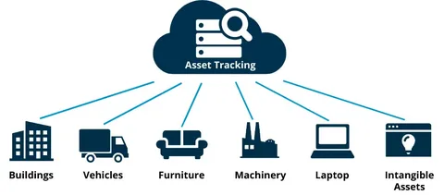
Technologies and Assets
IoT Sensors: Real-time shipment tracking
Blockchain Smart Contracts: Immutable documentation
AI Analytics: ETA, route risk, customs delay prediction
Cloud Infrastructure: Real-time scalability
Mobile App: Track & manage shipments anywhere

Slide 12

Expected Business Value
30% reduction in lost or delayed shipments
40%-time savings in customs processing
25% increase in operational efficiency
3 new revenue channels from subscriptions, APIs, and consulting
Strong competitive edge with transparency and ESG compliance

Slide 13

Ensuring Project Success
Set measurable KPIs and real-time dashboards
Conduct pilot testing and stakeholder review cycles
Integrate user feedback into bi-monthly sprint cycles
Offer continuous training for clients and employees
Maintain cybersecurity audits and compliance updates

Slide 14
Conclusion
LogiFlow is redefining logistics by combining IoT and blockchain to bring clarity, control, and collaboration into complex supply chains. With a clear roadmap, strong technological foundation, and scalable business model, LogiFlow is positioned to lead the future of smart global logistics.

Slide 15





THANK YOU FOR LISTENING ♥

